Slide 1

Second International Summit on Human Genome Editing November 27-29, 2018 Hong Kong
Genome Editing of Heritable Diseases:
Technical and Societal Considerations
Some Comments on Duchenne Muscular Dystrophy
R. Rodney Howell, M. D.
Miller School of Medicine
University of Miami
Miami, Florida USA

Slide 2
Duchenne Muscular Dystrophy (DMD)
Guillaume-Benjamin-Amand Duchenne, French physician born more than 200 years ago, studied medicine in Paris, and died in 1875. He provided accurate descriptions of
many neuromuscular disorders, including pseudohypertrophic muscular dystrophy to which his name is attached today (Duchenne Muscular Dystrophy)
One of the more common fatal genetic diseases in childhood
This X-linked genetic disease has an incidence in most studies of between 1 in 4000 to 1:5000 in boys
Mean age of death in the 1960s was 14.4 years, but this had increased and since the 1990s with ventilation, steroid use and other health-care improvements to 25.3 years of age
Duchenne Muscular Dystrophy remains uniformly fatal
The defect in DMD was discovered in the 1980s by Kunkel to be a deficiency of the protein he named dystrophin, the largest protein in the human body
In spite of this ground-breaking discovery over 30 years ago, no specific treatment has been available for Duchenne muscular dystrophy until recently, and still no curative treatments are available.
The disease has been an focus of extensive study over the past 50 years led by two very large voluntary health organizations, the Muscular Dystrophy Association in the United States, and the Association Francaise Contre Les Myopathies (AFM) in France, in addition to large numbers of smaller groups world wide in addition to the National Institutes of Health and other similar groups
The widespread efforts of these organizations has made Duchenne Muscular Dystrophy one of the best known genetic disorders among the general public

Slide 3
Duchenne Muscular Dystrophy
Corticosteroid treatment is the standard of care in Duchenne muscular dystrophy worldwide and has been shown to be clearly beneficial in both survival and function, although not specific in its action
There has been extensive work delineating both the number and types of genetic mutations in Duchenne muscular dystrophy and there are current (2015) data in the TREAT-NMD DMD Global data base on more than 7,000 DMD mutations
A total of 5,682 large mutations have been observed, of which 4,894 were deletions (1 exon or larger) and 784 duplications (1 exon or larger)
There were 1,445 small mutations (smaller than 1 exon) and 358 were small deletions and 132 small insertions and 199 affected splice sites
Point mutations totaled 756 with 726 nonsense mutations and 30missense mutations; there were 22mid-intronic mutations
Mutations identified within the database that would potentially benefit from novel genetic therapies for DMD including stop codon read-through therapies (about 10% of mutations) and exon skipping therapy (eventually up to 55% of the total mutations)

Slide 4
Mutation Suppression
Ribosome
Stop Codon Mutations
UAA
UGA
UAG
Arg
5’
3’
5’
3’
GCC
Gent
Ataluren
UAA
Gentamicin or Ataluren -Premature stop
complex

Slide 5
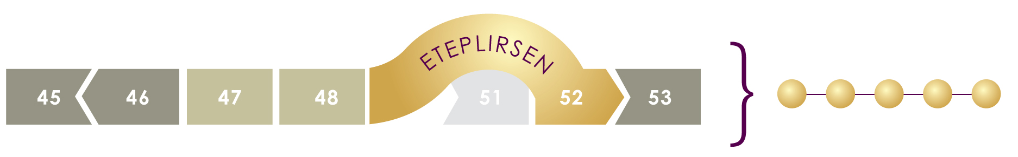
Exon-Skipping Approach
SKIPPING EXON 51 ENABLES PRODUCTION OF FUNCTIONAL DYSTROPHIN PROTEIN (targets dystrophin region where skipping 51 corrects 13% DMD mutations)
Dystrophin

Slide 6
Duchenne Muscular Dystrophy
Drug development has focused on the known mutations for DMD
Currently, only one specific drug is FDA approved in the USA for DMD caused by deletions at exon 53 but that drug will be effective in about 13% of the DMD population; although very safe, the beneficial drug effects are not dramatic
Gene therapy trials are underway, and very encouraging. Since the full-length gene for dystrophin is much too large to fit within the viral vectors this requires the use of a “mini-gene”, and the shortened dystrophin produced when effective will produce a Becker-like phenotype
Specific, life-saving therapies for Duchenne Muscular Dystrophy are urgently needed

Slide 7
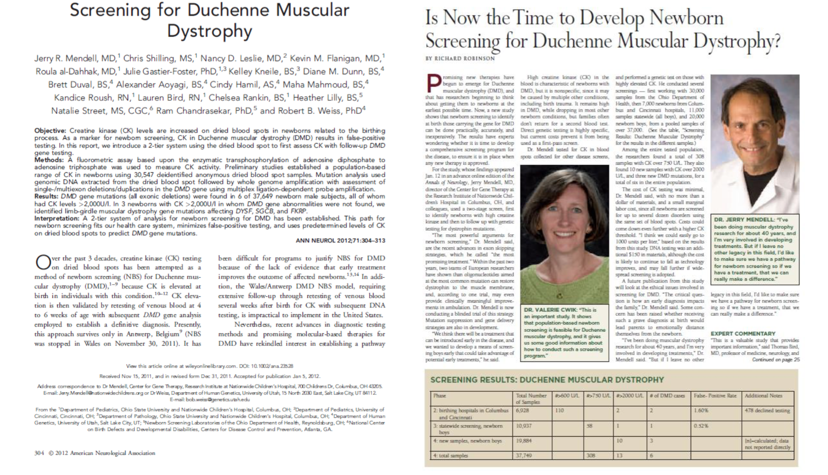

Slide 8
Newborn Screening for Genetic Disease in the United States
Routine newborn screening has been carried out in all 50 states since the 1970s; the programs have always been state sponsored public health programs, arguably one of the most successful ones
Conditions such as phenylketonuria, with simple, reliable screening tests and proven treatment efficacy have been the targets of testing
Over the years, congenital hypothyroidism and a handful of other diseases were added on a state by state basis
As the programs grew and developed, there was extraordinary variation from state to state and there was little systematic evaluation of either the rationale for screening and/or the outcomes of such screening
Over 4,100,000 infants are screened each year, making newborn screening among the most commonly performed genetic testing in the United States

Slide 9
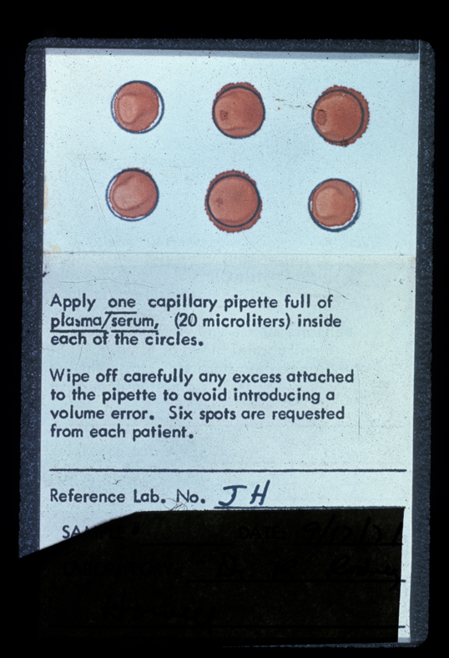

Slide 10
Recommended Uniform Screening Panel For Newborn Screening in the United States By the Federal Advisory Panel Includes 35 Core Conditions (As of July 2018)
Organic Acid Condition 9
Fatty Acid Oxidation Disorder 5
Amino Acid Disorder 6
Endocrine Disorder 2
Hemoglobin Disorder 3
Other Disorders 10
Biotinidase Deficiency
Critical Congenital Heart Disease
Cystic Fibrosis
Classic Galactosemia
Glycogen Storage Disease Type II (Pompe Disease)
Hearing Loss
Severe Combined Immunodeficiencies
Mucopolysaccharidosis Type 1
X-linked Adrenoleukodystrophy
Spinal Muscular Atrophy

Slide 11
Newborn Screening for Duchenne Muscular Dystrophy (DMD)
Screening will make use of the standard dried blood spots currently collected from every infant in the United States for newborn screening
The initial test is for Creatine Kinase (CK) which has been shown to be substantially elevated in newborn infants affected with DMD.
It has been shown that CK-MM, one of the three isoenzyme forms of CK found predominately in skeletal muscle can be reliably measured in dried blood samples, and measuring this isoenzyme by a fluroimmunometric assay enhances the reliability of the CK assay for newborn screening
Infants with elevations (usually large) of CK above an established normal for the newborn period will have the DNA from the same dried blood spots subjected to DNA sequencing and mutation analysis for whole genome amplification
Since current treatments are mutation-specific, it is recommended that comprehensive sequencing be performed in order to be available for therapies currently under development

Slide 12
Duchenne Muscular Dystrophy(DMD) Moving Forward
It is likely that we will soon have newborn screening for DMD which will identify virtually every person with Duchenne Muscular Dystrophy in the USA and many other countries
Patients and their families know a great deal about DMD are very much aware of the developments that might lead to specific treatments
A recent e-mail I received from a mother from India temporarily residing in Florida provides a family perspective which we hear:
“My son is suffering from DMD. I came to know at the age of 4—(describes how diagnosis was made). He is currently 8 years old and able to do almost all things on his own. I have read about the new technique crispr cas9 to cure human diseases. Is there any way using the above technique in DMD? We are ready to do anything for him. Currently he is in a very good condition, please give him one chance.”

